Slide 1
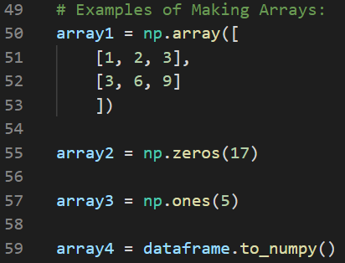
What are numpy arrays?
Store data as a grid/matrix
All data has to be the same data type
Will convert ints to floats automatically
Access with numpy package
import numpy as np
Rather than having elements removed or replaced like in lists, the entire array is deleted and recreated each time it is manipulated
How to index and slice numpy arrays:
Indexing begins with 0 just like in lists
Slicing = indexing for numpy arrays
Use same format as lists [start:stop:step], have to have square brackets
Have to overshoot the stop because the stop value is not included in the output
Examples:
[2,4] = pulls value in third row, fifth column
[3:7, 3:4] = pulls values in rows 4-6, column 4
[ :8, 6] = pulls all rows from 1st row to 9th row in 7th column
[ : , 1] = all rows in the second column (can do it the other way for columns too)
array_name[5] = pulls the 6th row of data
Important Functions:
np.mean = finds the average of the array
np.median = finds the median value in the array
np.std = standard deviation of the array
np.sum = the sum of all the elements in the array
np.round = rounds the output of the input parameter to a specific number of decimals
np.min() = minimum value in the array
np.max() = maximum value in the array
For all the functions above, can choose which axis they apply to (i.e rows or columns)
axis = 0 : this summarizes across all rows
axis = 1: this summarizes across all columns
Or can use indexing to choose which part of the array it applies to
How to make numpy arrays:
See picture for multiple examples of numpy array types
np.array creates a general array. This is good for simple arrays when you want to put all the numbers in yourself.
np.zeros creates a 1-D array entirely of zeros of whatever size you put in the parentheses.
np.ones does the same as np.zeros just with ones.
dataframe.to_numpy() turns a dataframe into a numpy array
This can be done on regular dataframes that have been created by hand, or on dataframes that were generated by pulling data in from an outside file (this is the method we have used to pull data in for our forecast competition thus far)
Key Methods:
.append() = adds elements to the end of an array (creates a copy of an array)
.insert() = inserts an element in a specific index spot (creates in a copy of an array)
.empty() = deletes all the values in an array that has been assigned to a variable
Key Attributes:
.ndim = dimensions
.shape = rows and columns (if 2-D), # of elements/dimensions (if 1-D)
.dtype = data types housed in the array
Numpy Cheat Sheet

